Slide 1



Slide 2
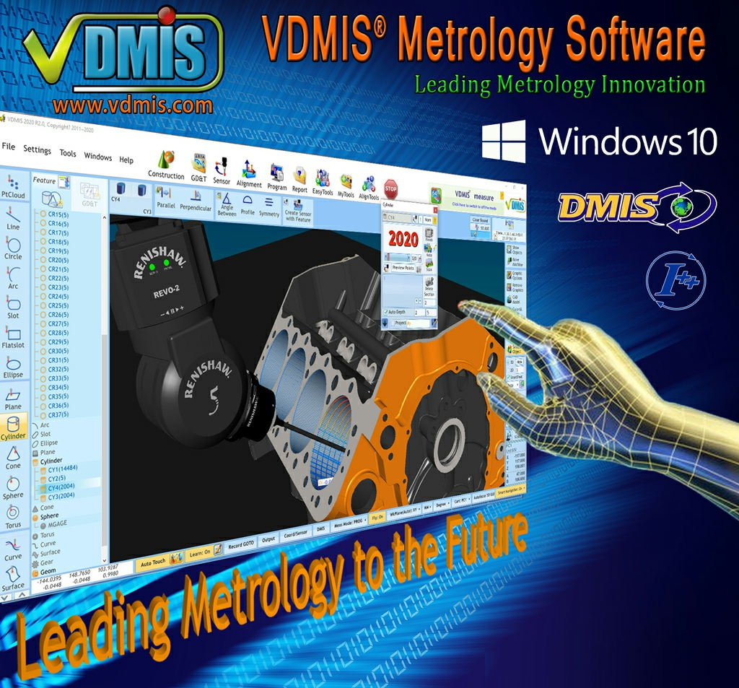


Slide 3




Controllers Supported by VDMIS
All Controllers
UCC T3 Series
UCC S3
UCC T5
UCC S5

Slide 4
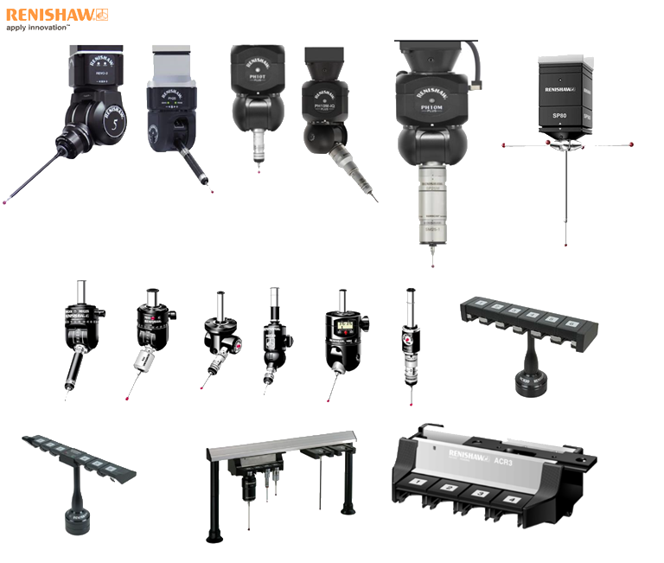
Probe Heads Supported by VDMIS

Slide 5
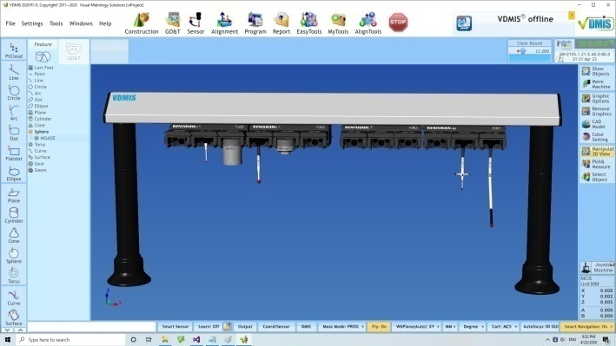
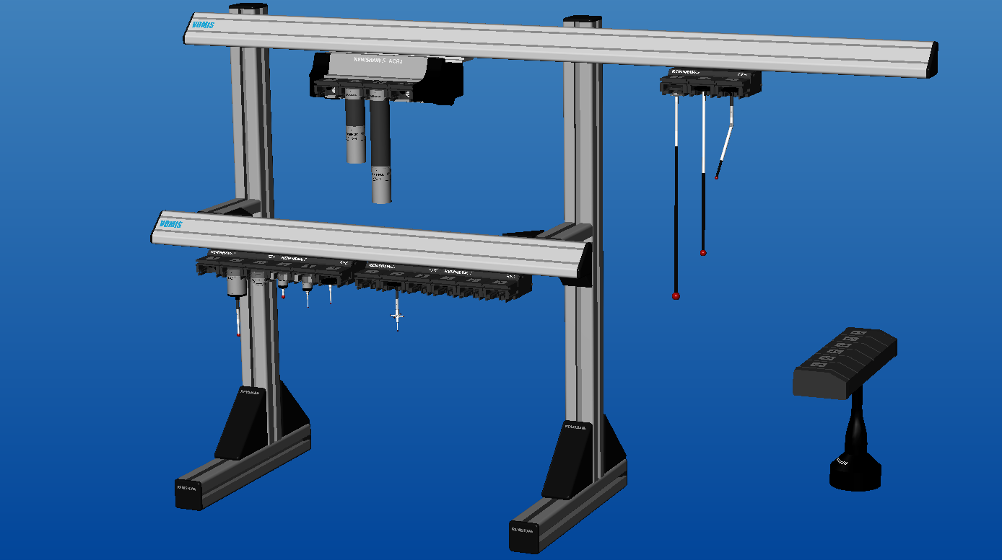
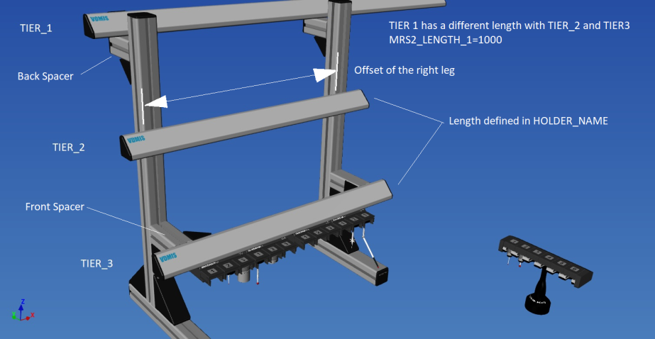
Sensor Component Assignment and Sensor Holder Configuration
Easy sensor component holder configuration
Easy graphical sensor assignment on racks
Virtual sensor changing animation

Slide 6
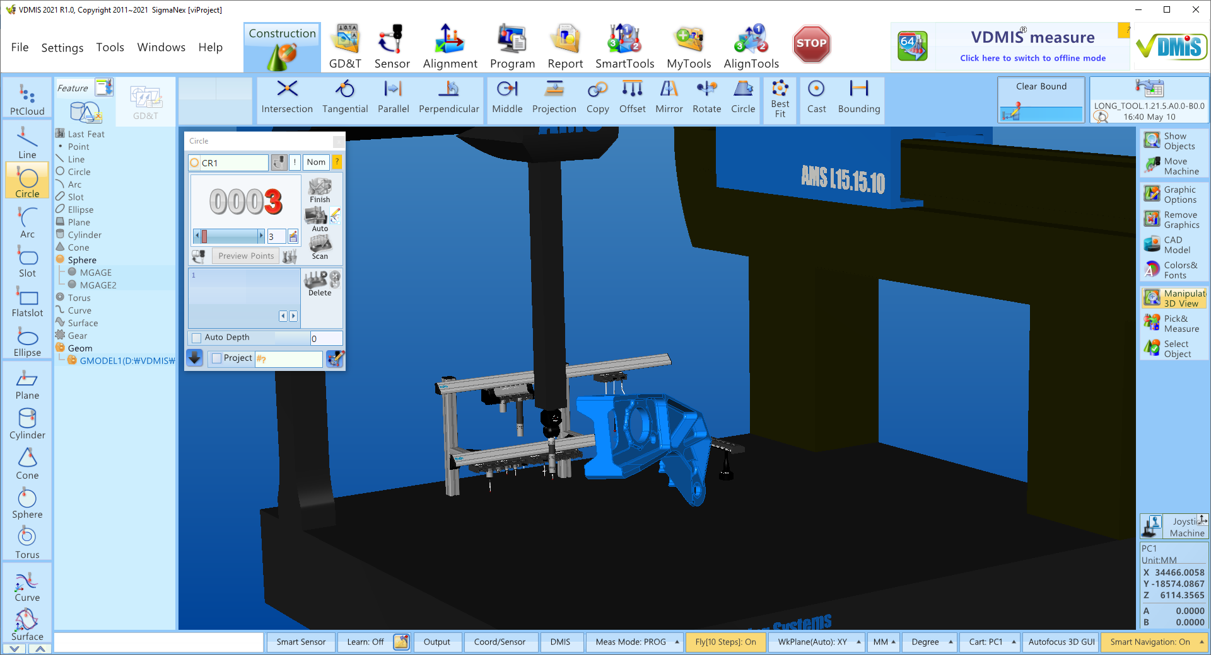
VDMIS Smart User Interface
Usability without Compromising Functionality
Main Menu
Clear Surface
Smart Function Bar
Measuring Window
Machine Status
Graphic Toolbar
Sensor Holder
Features and GD&T Database
Joystick Control
CAD Model
Features Measure Bar
DRO
Main Status
Virtual Sensor

Slide 7
VDMIS Smart User Interface
Single page software, minimized cascading windows
Drag and drop capability.
Any function is reachable with short mouse move and just 1 click.
Intuitive and actionable large size icons with text title so any function could found rapidly to minimize learning curve and aid speed of use.
Completely designed in Windows 10, 64-bits
First Metrology software to use “Text to Speech” Windows 10 technology to guarantee the highest level of User-Software interaction.
High level of intelligence and diagnostic capability built-in VDMIS® to help the user completing the inspection process in the most efficient and smooth way possible.
Multimedia help –voice &Video available for every function with just right mouse click.
VDMIS® include digital code signing certificate issued by a Certificate Authority approved by Microsoft.

Slide 8
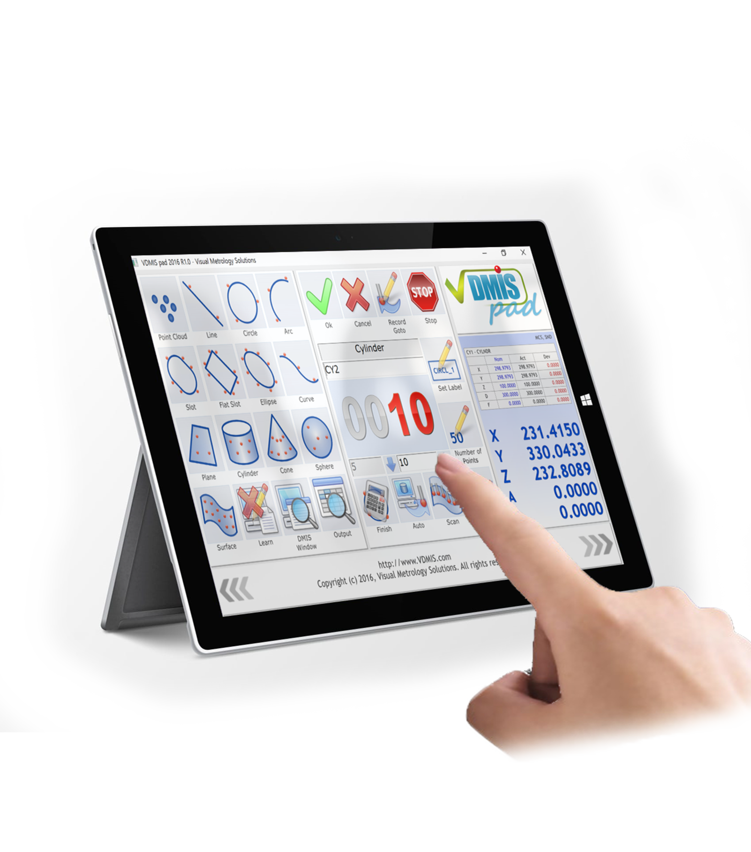
VDMIS Smart Touch
With just standard Windows 10 Tablet & VDMIS Smart-Touch App. you can reach all the CMM functions you will ever need while you are measuring parts on the CMM, no more running back to the CMM PC’s to select the functions you need.

Slide 9
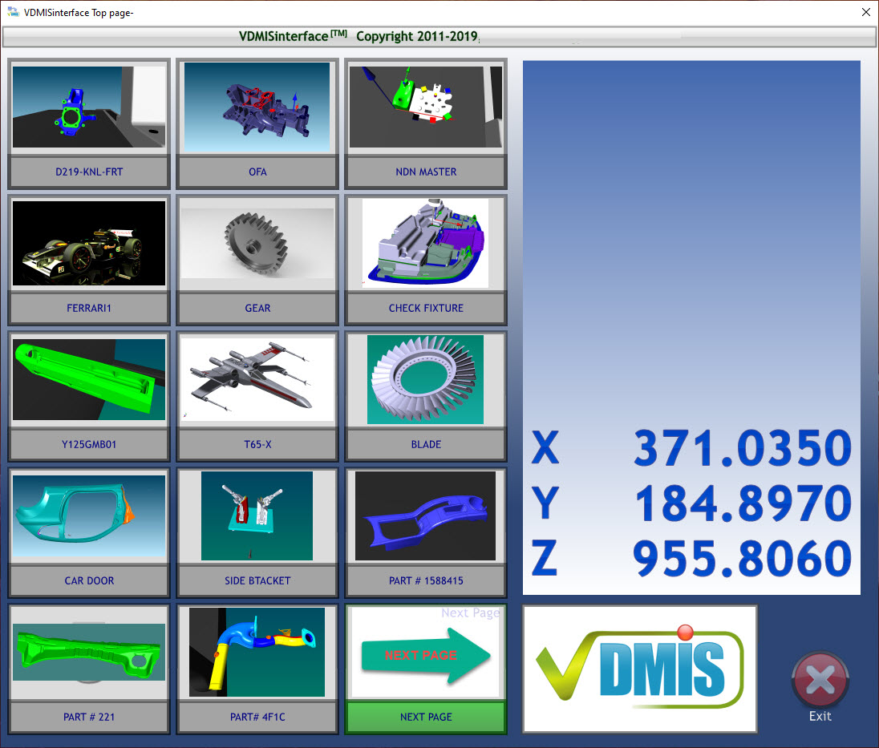
VDMIS Smart Interface
External DMIS program Interface
Iconize with Pictures
Easy to use for untrained operators
Unlimited Pages

Slide 10
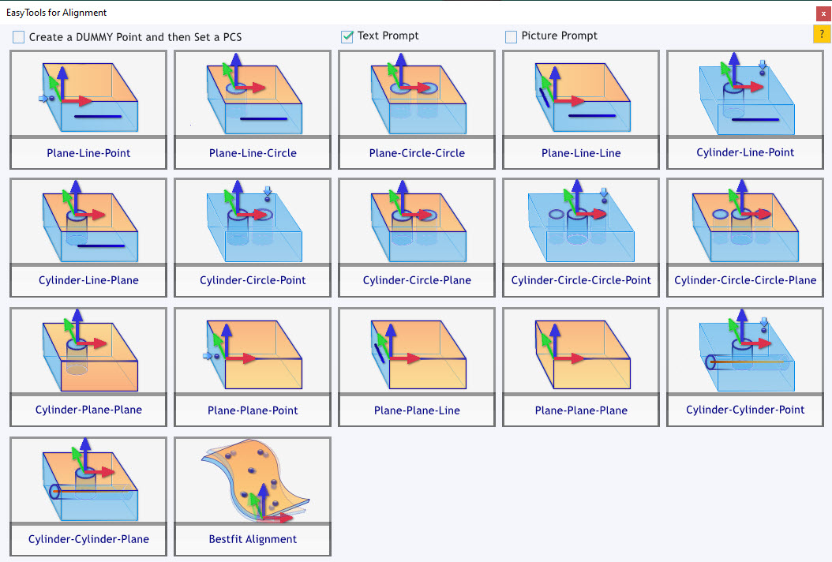
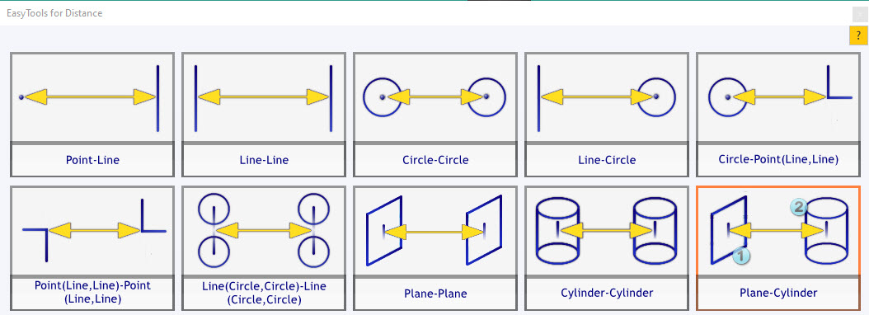
VDMIS Smart Tools
Step by step guide for alignment
Possible combinations for distances and angles

Slide 11
VDMIS Super Smart Programming
Smart CAD with
Smart Feature Recognition
Smart
Sensors
Super Smart DMIS Programming
Smart Navigation
Smart DMIS Editor

Slide 12
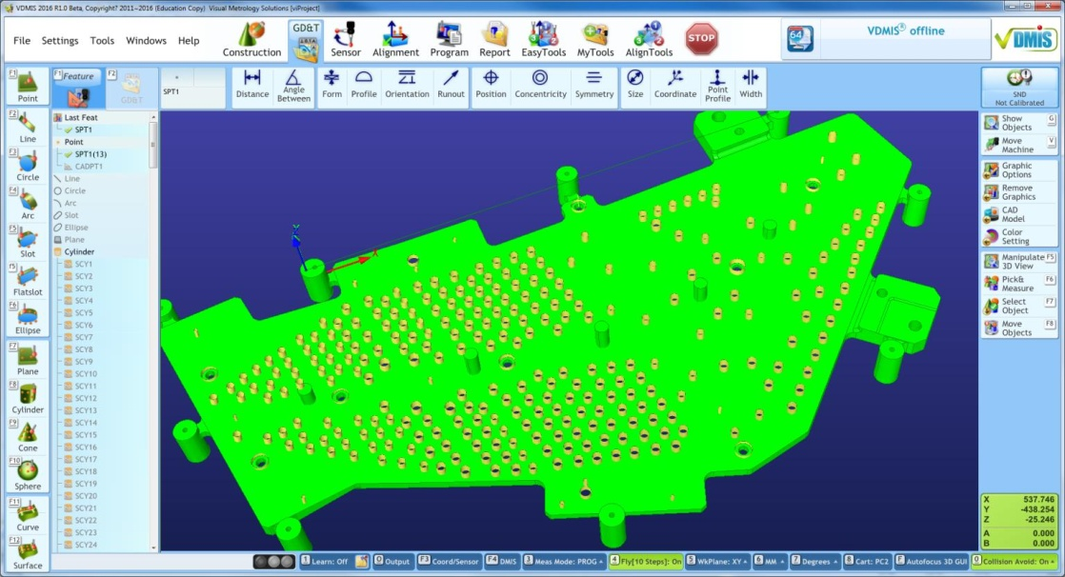
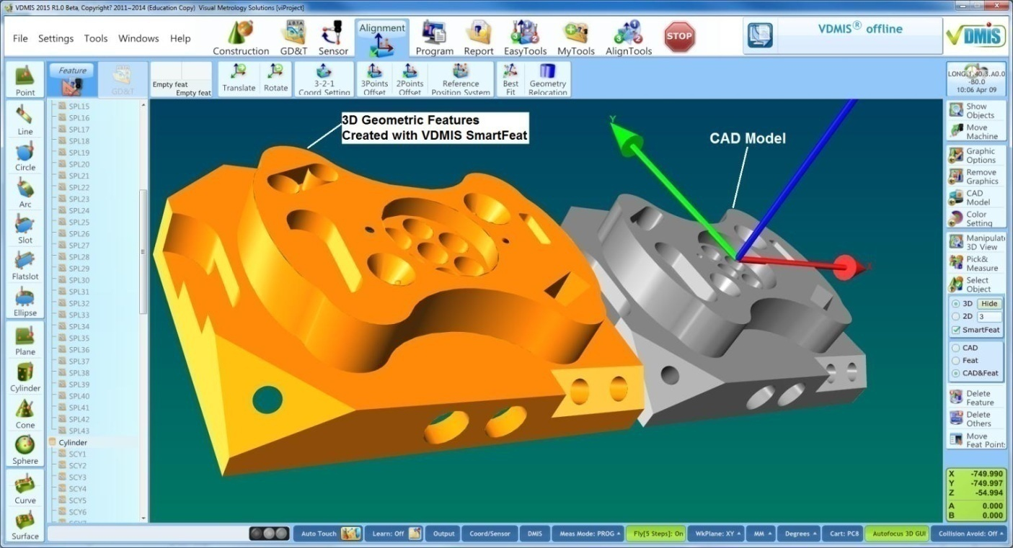
Smart CAD with
Smart Feature Recognition
Multi-Features Recognition on a Face
Compare a CAD Model and Created Geometry Features with Smart Feature Recognition

Slide 13
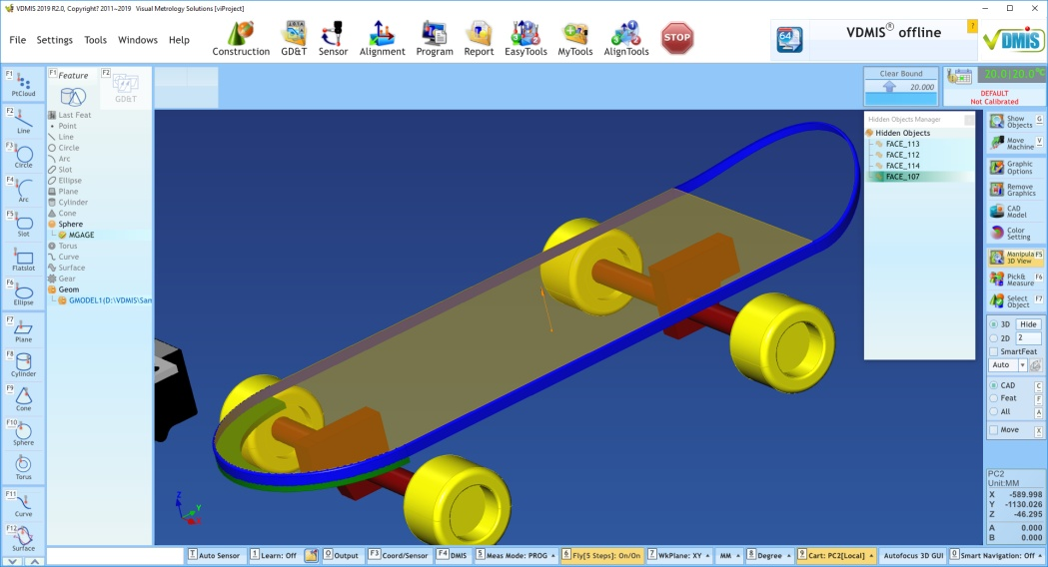
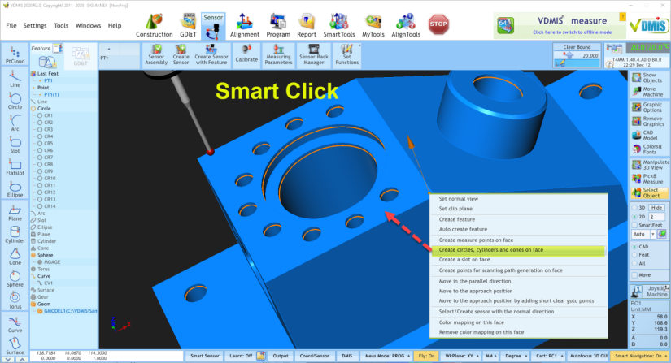
Smart CAD
VDMIS own Graphic Format – IVX and IVXR
- Easy handling graphic entities and color mapping
- Fast manipulating graphic entities
Direct CAD Import
Standard CAD formats
- STEP
- IGES
Optional CAD formats
- CATIA V6 – 3DXML
- CATIA V5, V4
- ProE
- SolidWorks
- Unigraphics
- Parasolid
- Solid Edge
- Inventor

Slide 14
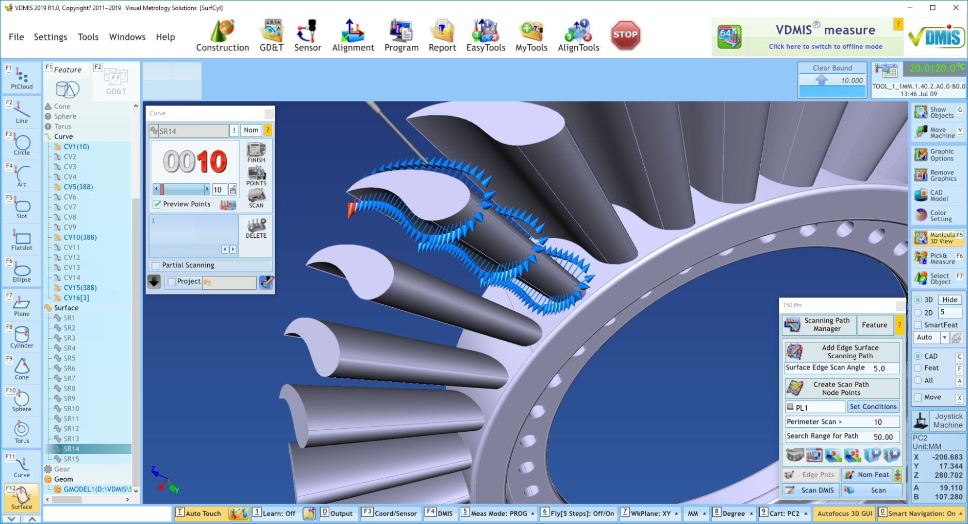
VDMIS Smart Measuring Point Generation
Easy measuring points generation on a surface

Slide 15
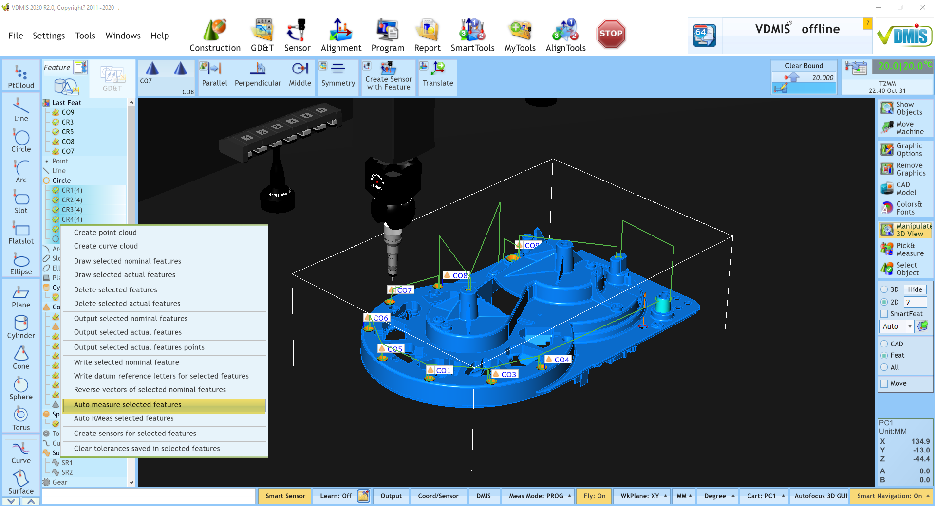
Smart Sensors and Smart Navigation
Smart Sensor: Auto creating sensors
Smart Navigation: Auto moving path generation with avoiding collisions
Easy and effective DMIS programming

Slide 16
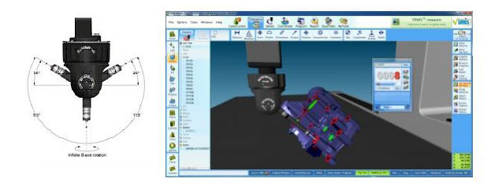
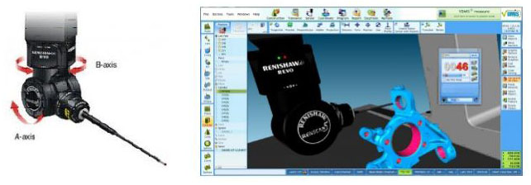
VDMIS Smart Modules – 5 Axis Probes
VDMIS supports 5 Axis Probe Heads: REVO, PH20
- Auto calculation of head angles for head touch with all axes and fixed quill
- Easy DMIS Programming with Smart Feature and Smart Navigation

Slide 17
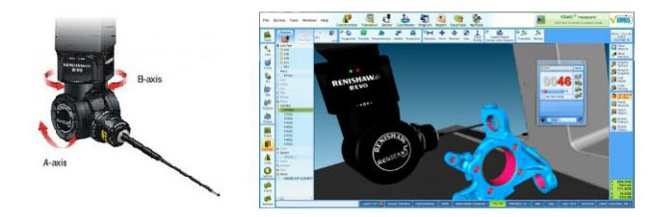
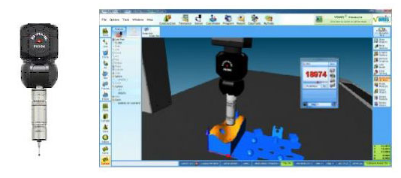
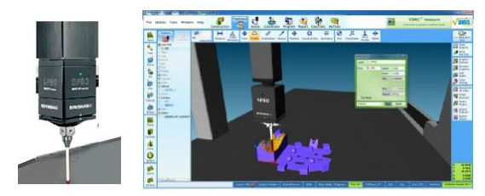
VDMIS Smart Modules – Smart Scanning
VDMIS supports the full range of scanning probes: REVO, SP800, SP25 and software scanning with TP20

Slide 18
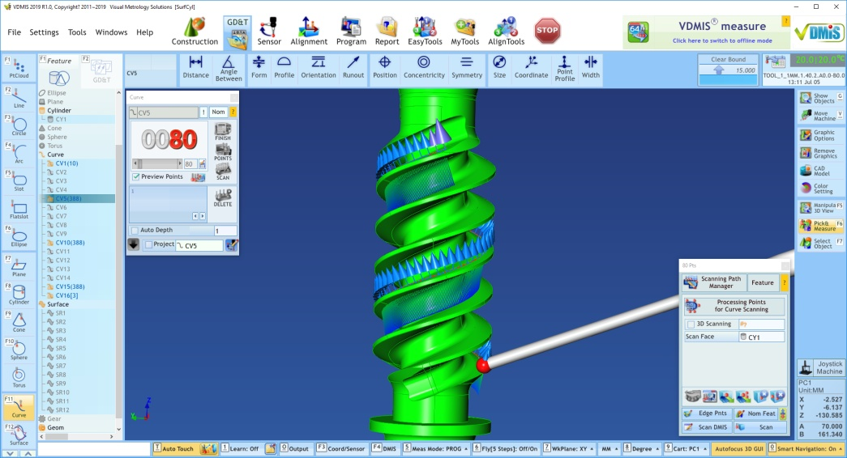
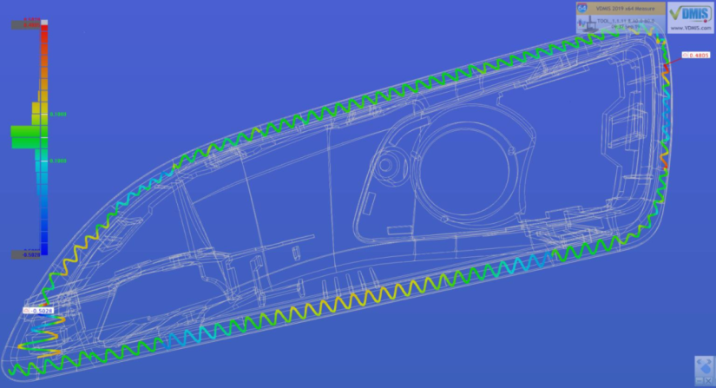
VDMIS Smart Modules – 5 Axis Scanning
5 Axis Scanning with REVO
- Edge sweep scanning
- Surface scanning
- Flat face scanning
- Helical scanning
- Smart navigation to avoid collisions
- Easy DMIS programming
Flat face scanning with sweeping scanning
3D curve scanning with 3D compensation

Slide 19
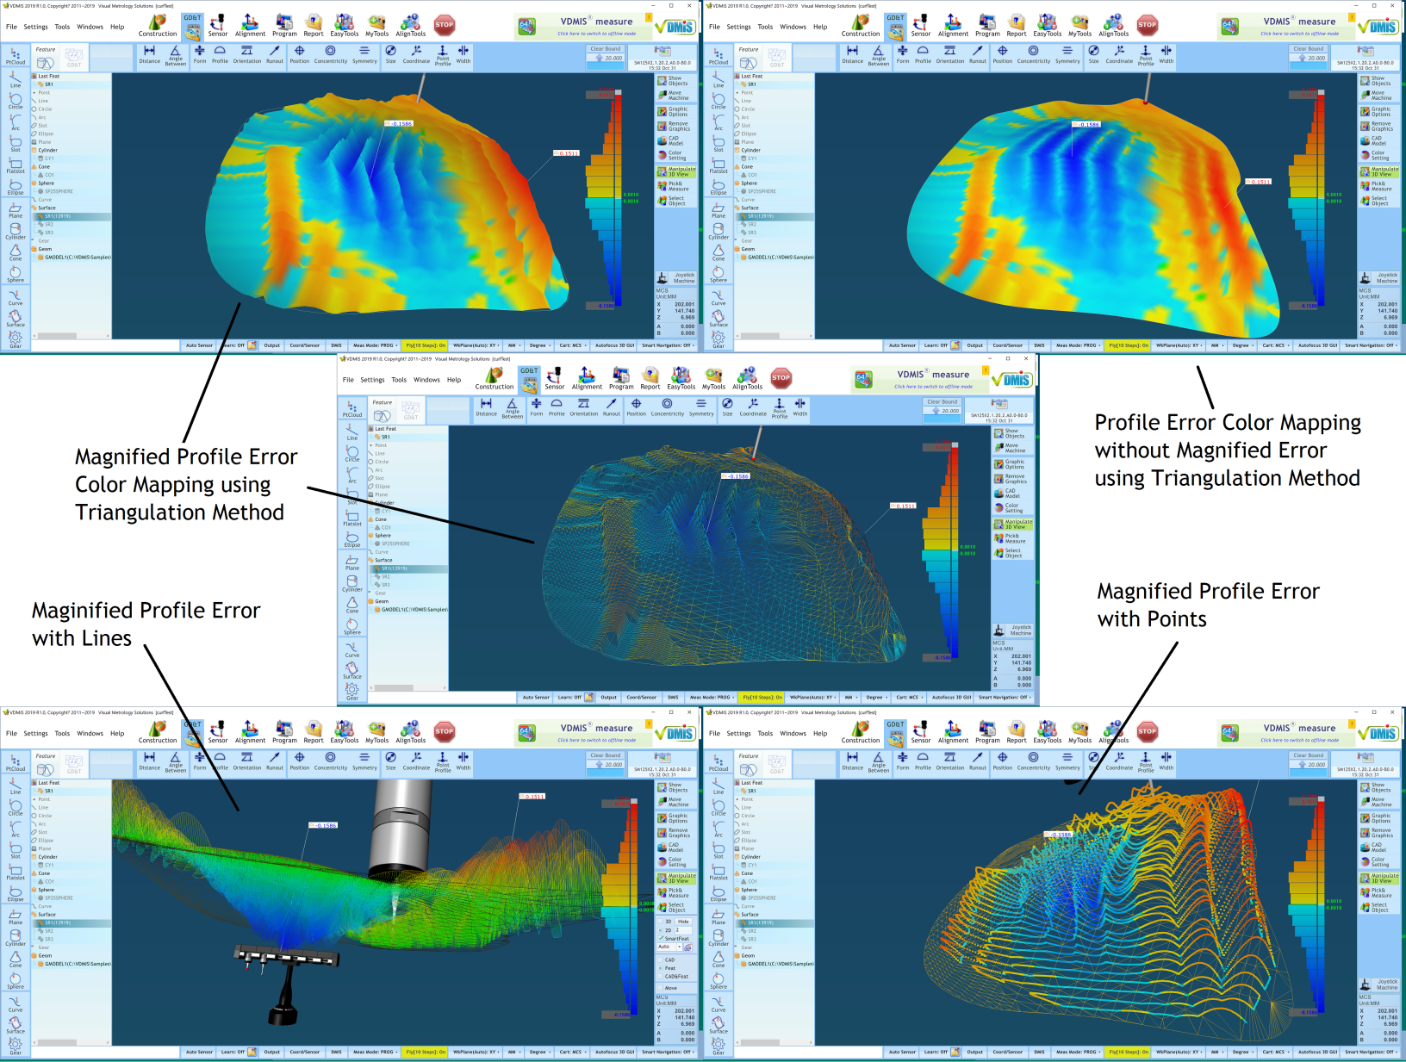
VDMIS Scanned Data Processing - Profile

Slide 20
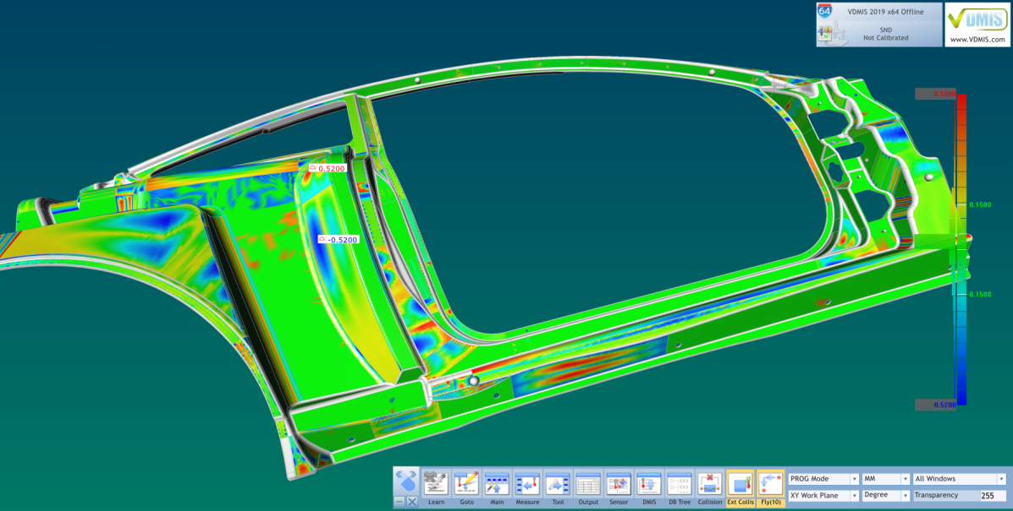
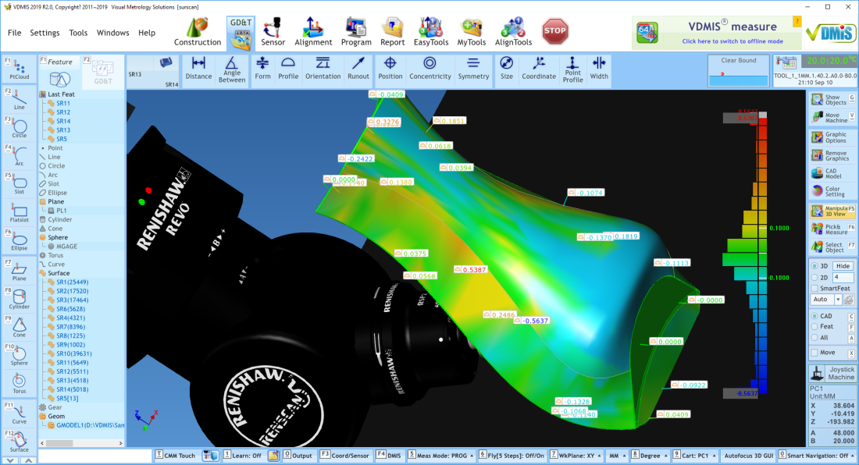
VDMIS Surface Cloud and Color Mapping
Several Surfaces can be measured separately but can be combined as a surface cloud
Individual profile error display with a click for an interested point

Slide 21
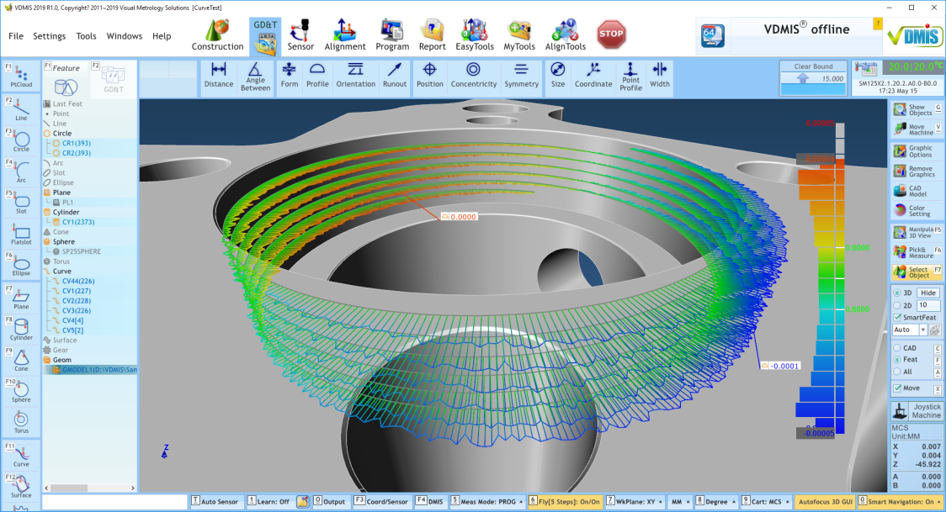
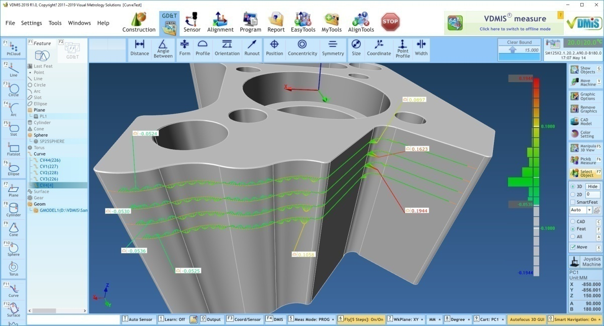
VDMIS Curve Cloud and Profile Error
Several curves can be measured separately but can be combined as a curve cloud for profile error analysis

Slide 22
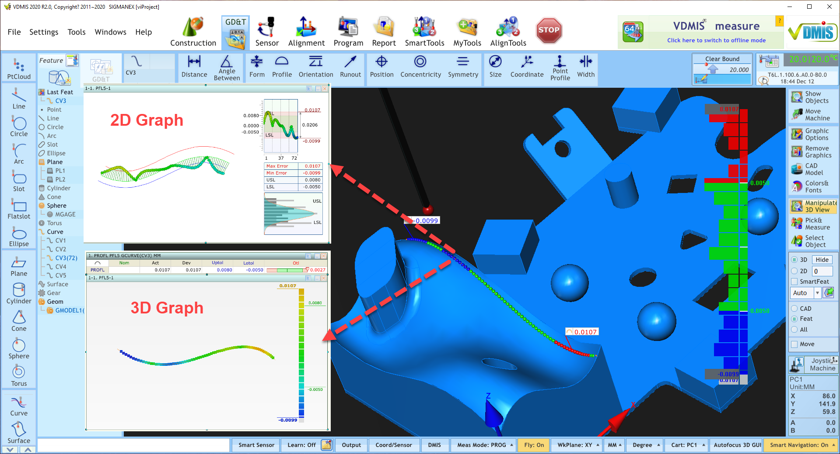
VDMIS Curve Profile Error

Slide 23
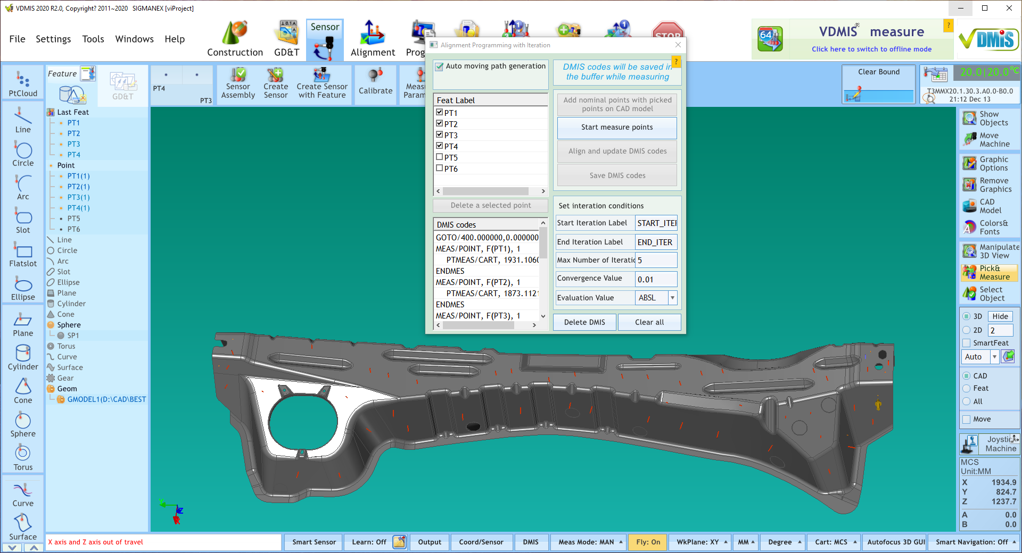
VDMIS Smart Tools – Smart Bestfit
Alignment of the part with the most complex shape like a “walk in the par”. Built with most powerful and intelligent algorithm to achieve the highest alignment accuracy with simple few steps.

Slide 24
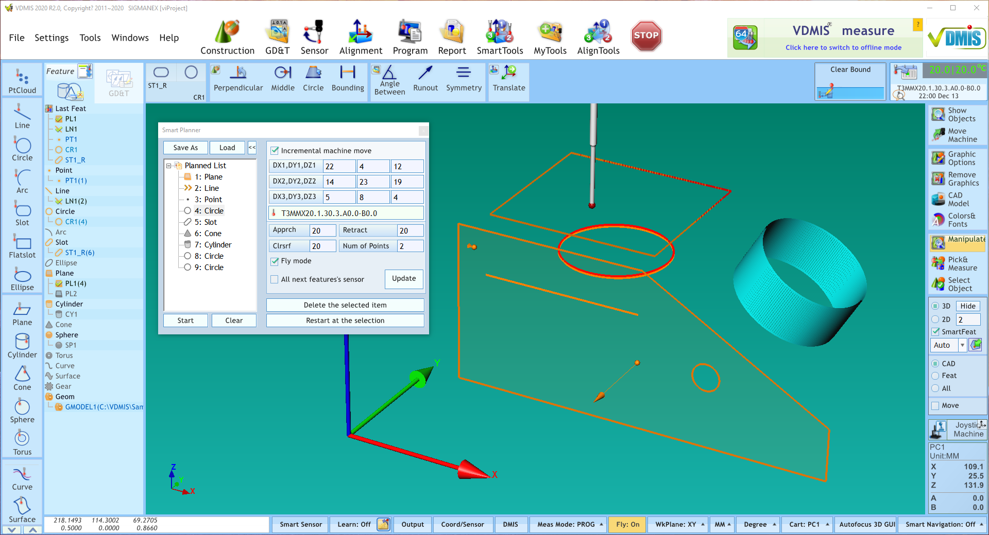
VDMIS Smart Tools – Smart Planner
This function will make any part inspection task extremely easy, simple and well organized. The user can make the full list of all the features to measure and assign the sensors, approach and retract needed for every feature before starting the measurement process.

Slide 25
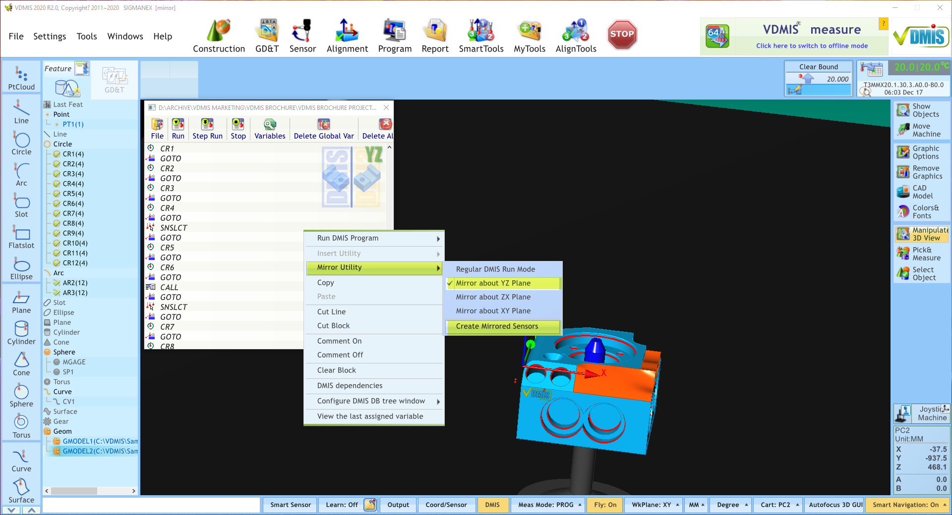
VDMIS Smart DMIS Program Mirror
With 1 magic click VDMIS® will mirror the DMIS part program and will create mirror sensors in sensors database so the new mirrored part program is ready to run immediately.

Slide 26
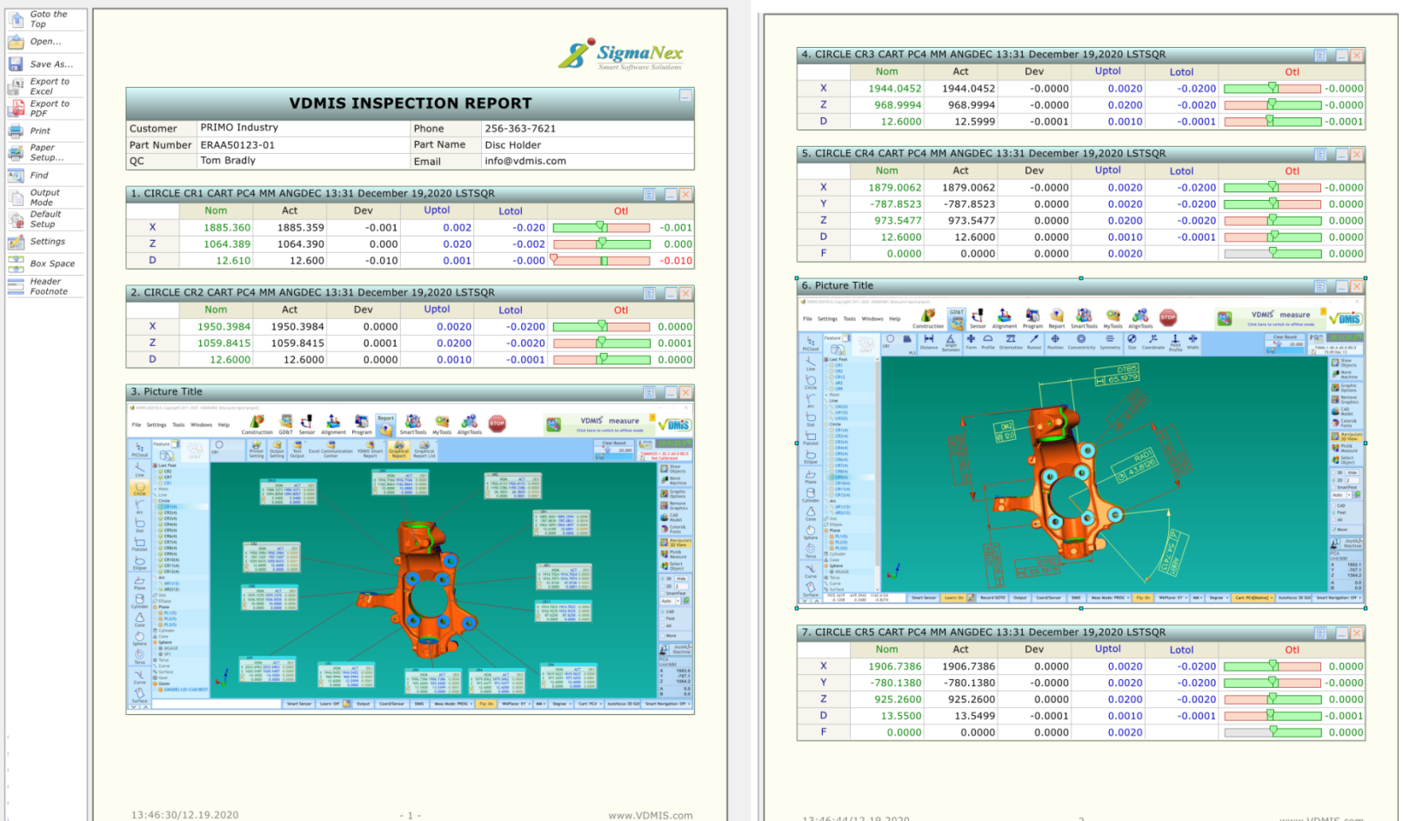
VDMIS Smart Report – Smart Report
Individual text output
Interactive live output – not dead text file
SPC
Graphical analysis
Export to Excel
Save as PDF

Slide 27
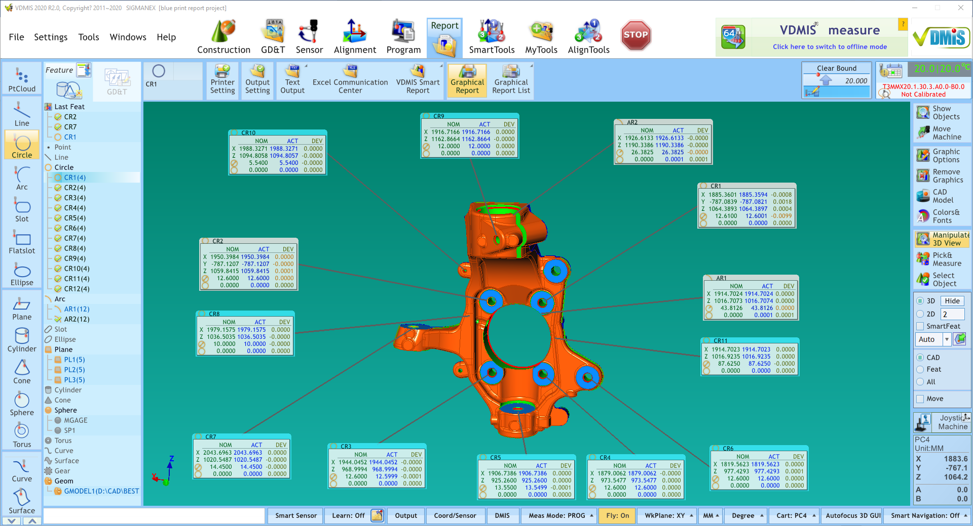
VDMIS Smart Report – 3D Graphical Report
Geometric features, GD&T, SPC and surface roughness
Auto-alignment windows
Save a format and recall a saved format
Save a screen, export to a PDF and to VDMIS smart report

Slide 28
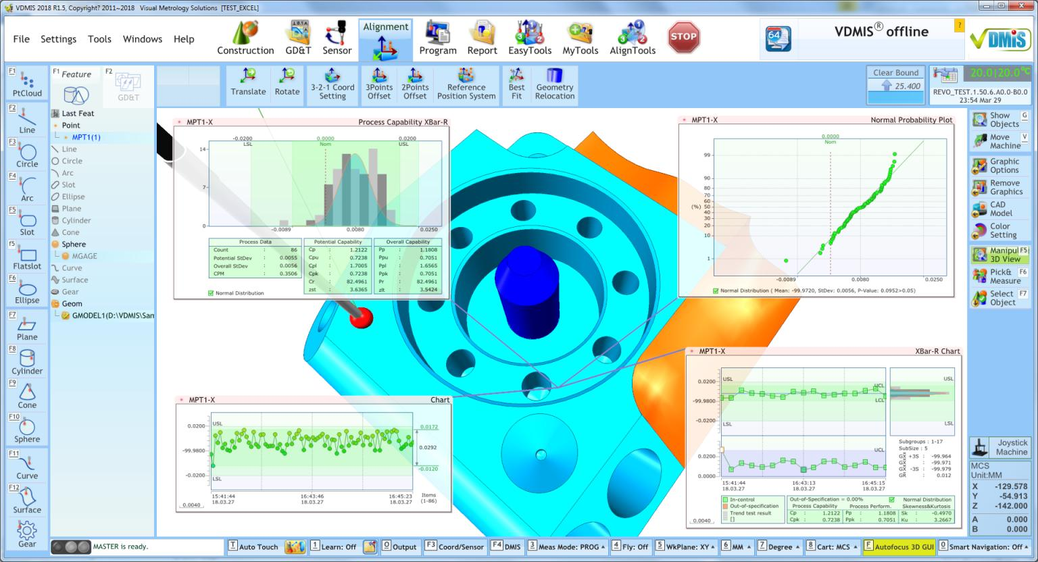
VDMIS Smart Report – 3D Graphical Report SPC
SPC in the 3D space with analyzed in the VDMIS smart report

Slide 29
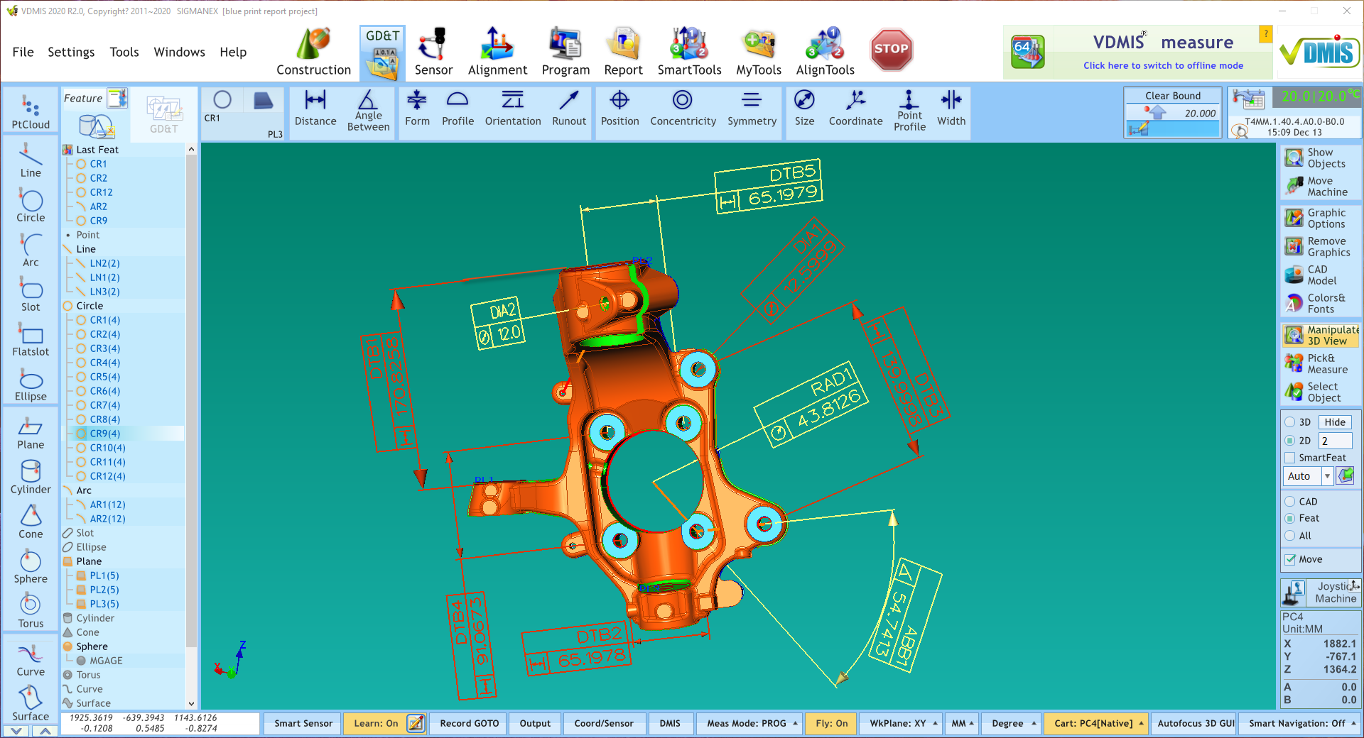
VDMIS Smart Report – 3D Blue Print Output
GD&T blue print output in the 3D space
Save the output and recall with DMIS program

Slide 30
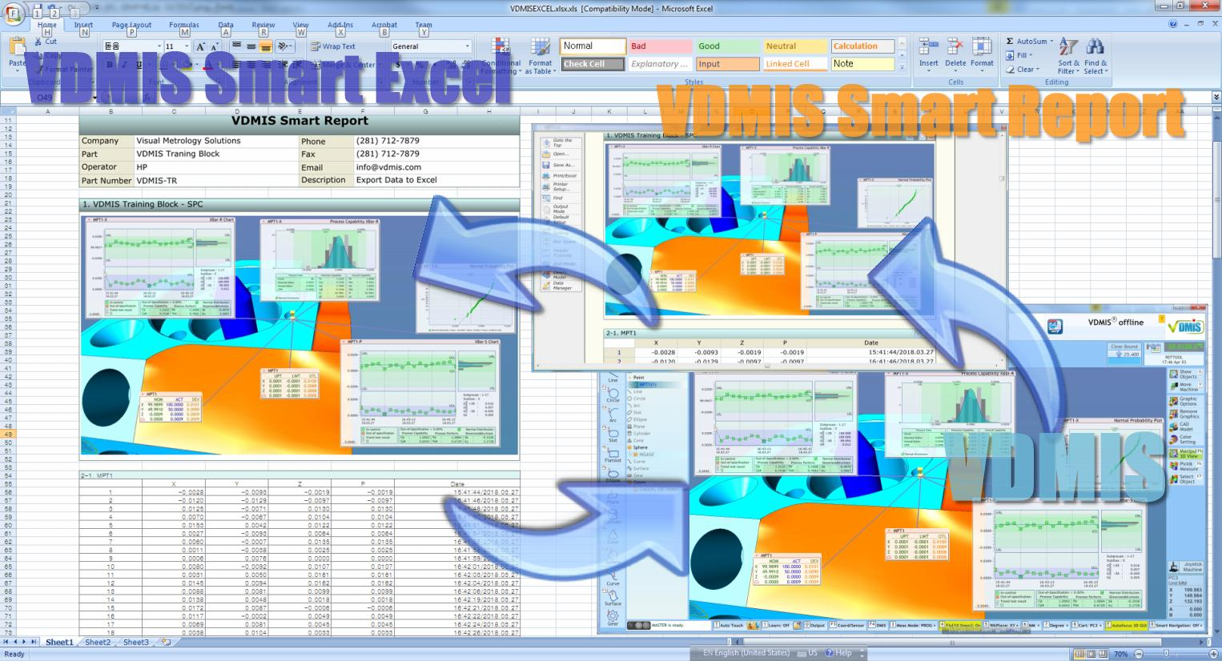
VDMIS Smart Report – Smart Report to Excel
VDMIS smart report data can be exported to a Excel file directly. Text output will be exported as texts and pictures will be exported as pictures

Slide 31
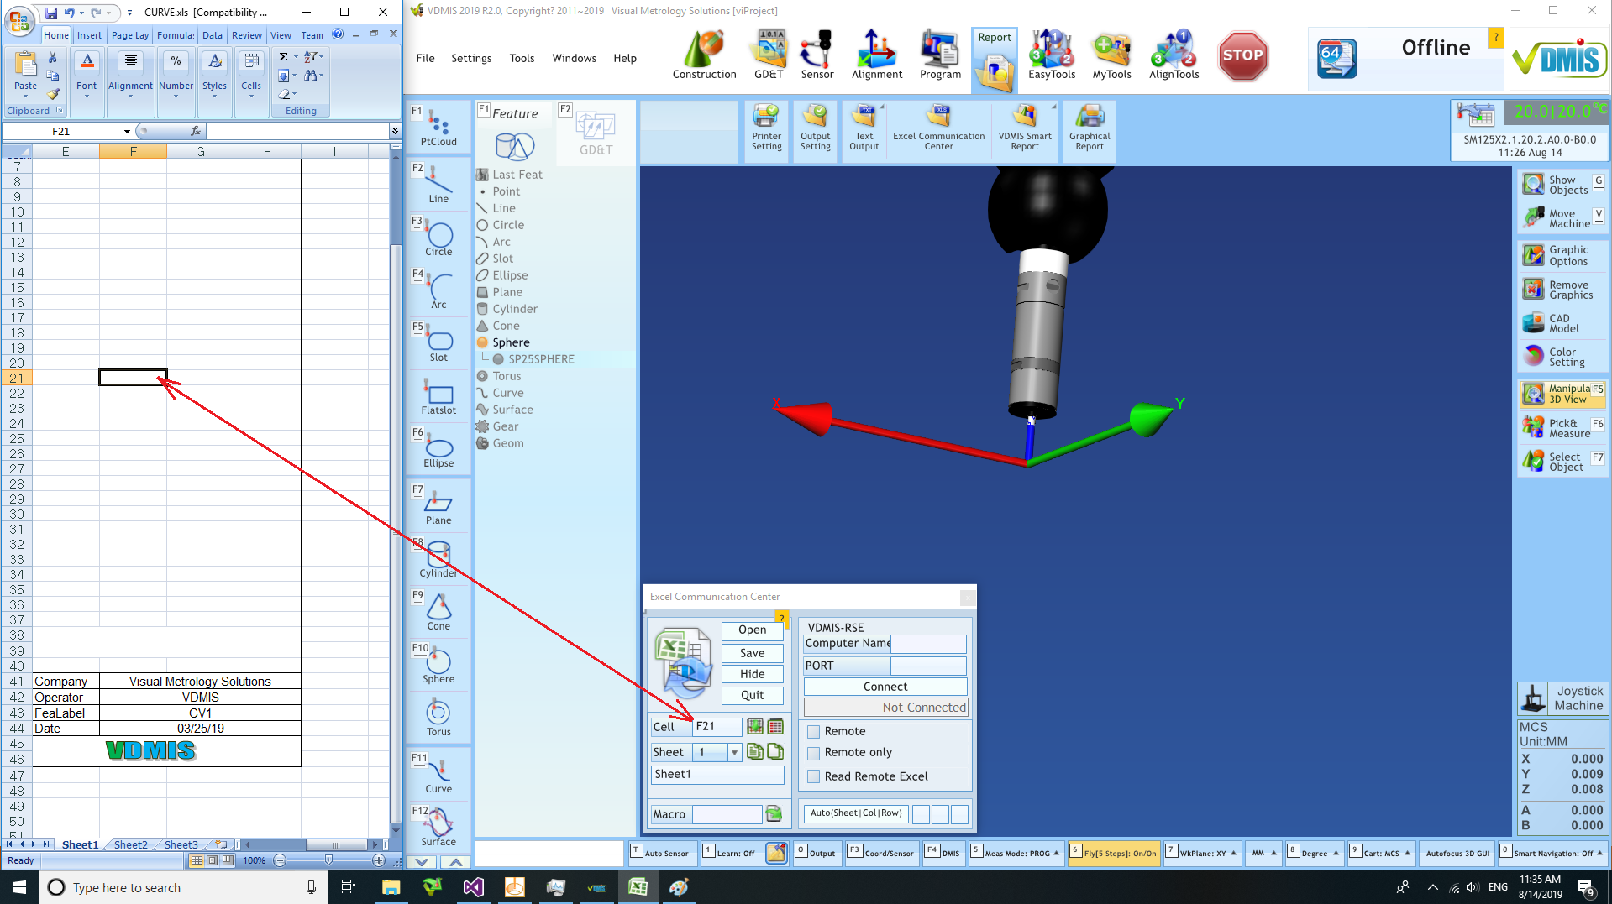
VDMIS Smart Excel
VDMIS smart Excel can output data to specified cell in an Excel template directly.
Read data from a cell and run a Excel macro in VDMIS directly

Slide 32
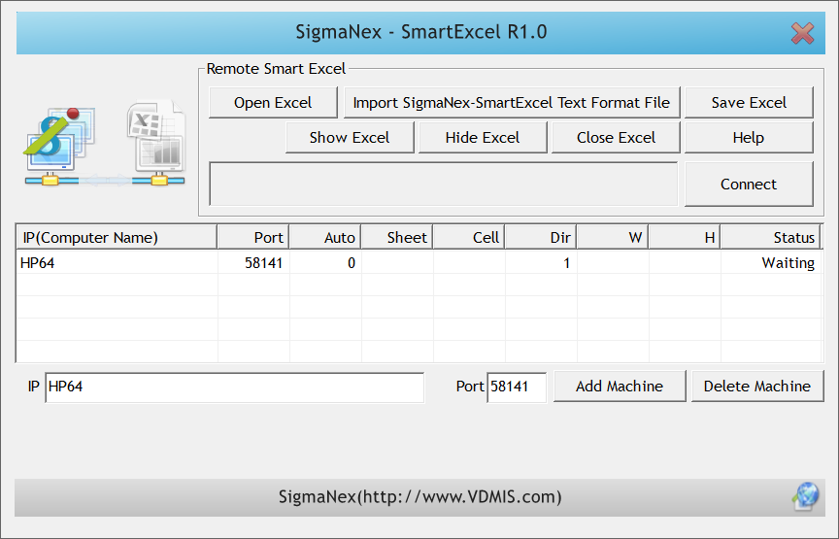
VDMIS Smart Remote Excel
VDMIS smart remote Excel can output data to specified cell in an Excel template directly on the other computers.
Read data from a cell of an Excel file on the other computers using TCP-IP communication

Slide 33
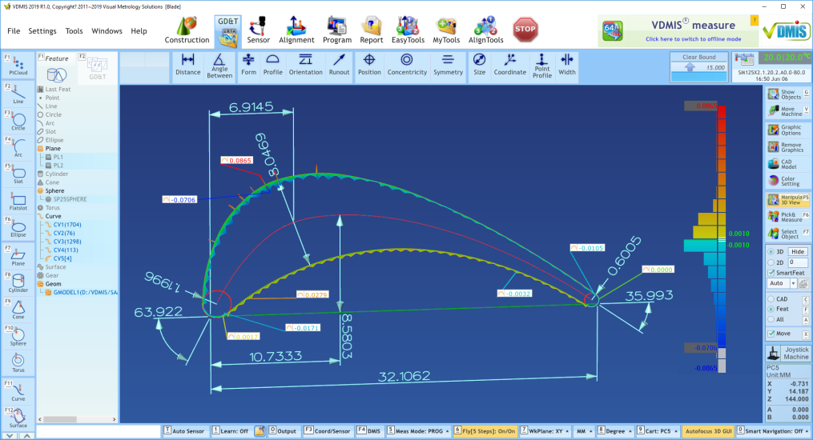
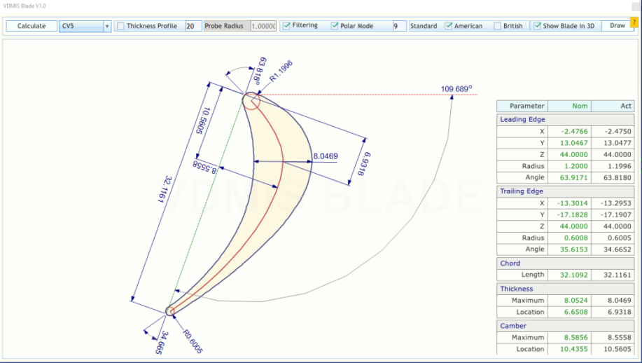
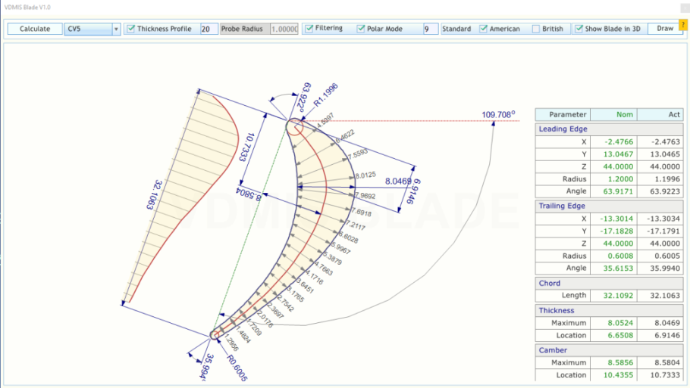
VDMIS Smart Blade
Measure 4 curves
Calculate blade data
Curve profile error
Filtering data
2D graphical output
3D graphical output

Slide 34
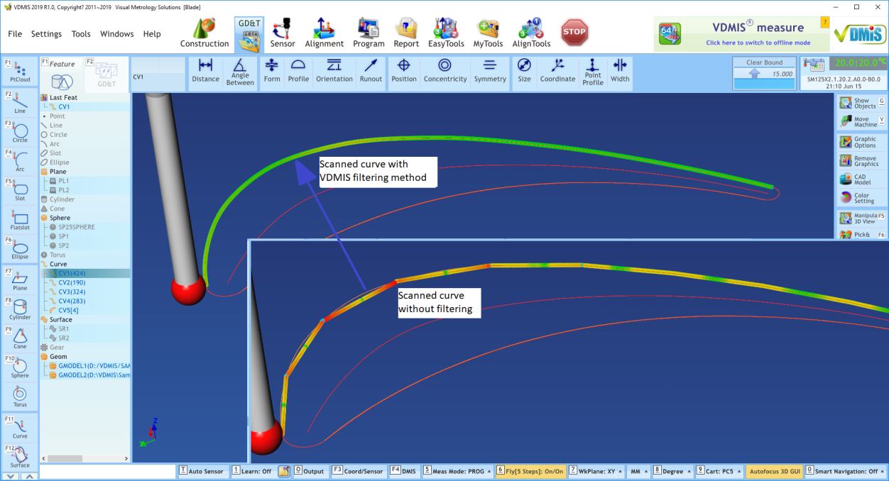
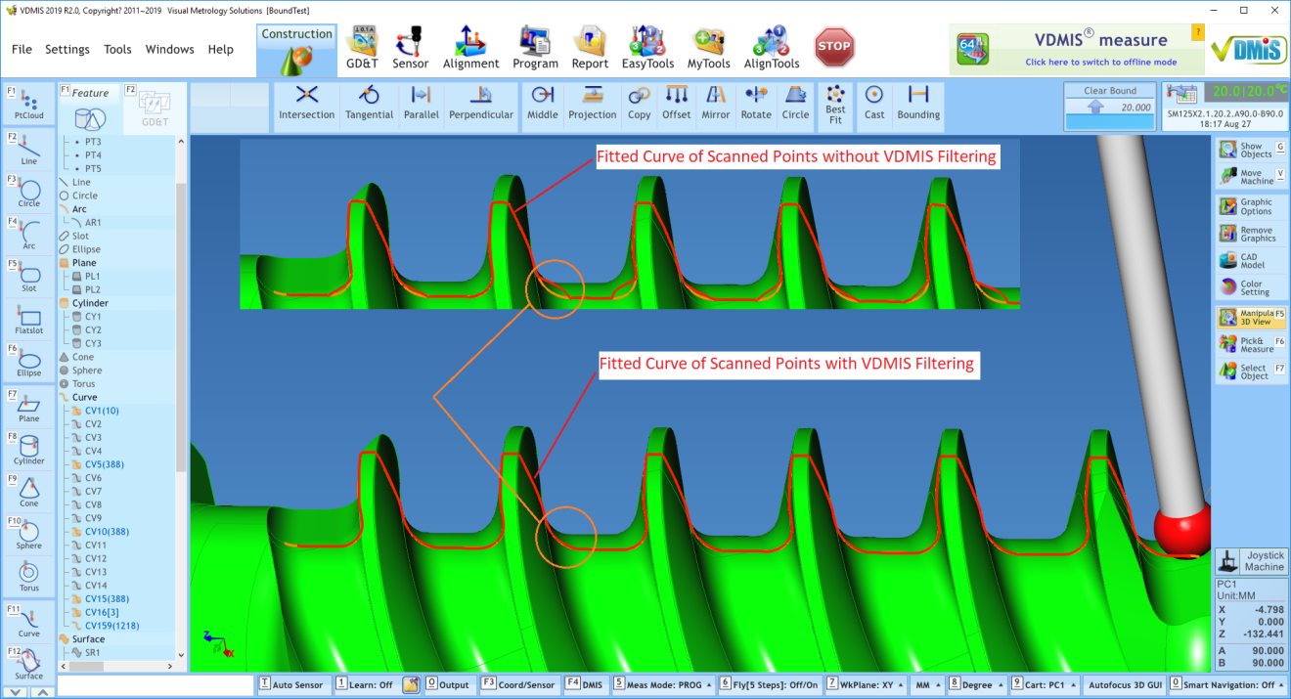
VDMIS Smart Data Processing
Filtering example

Slide 35
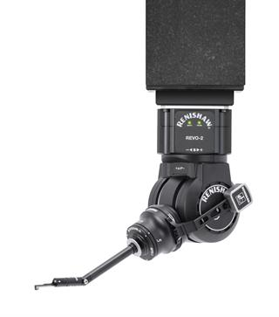
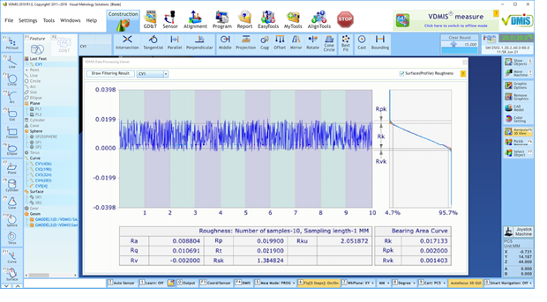
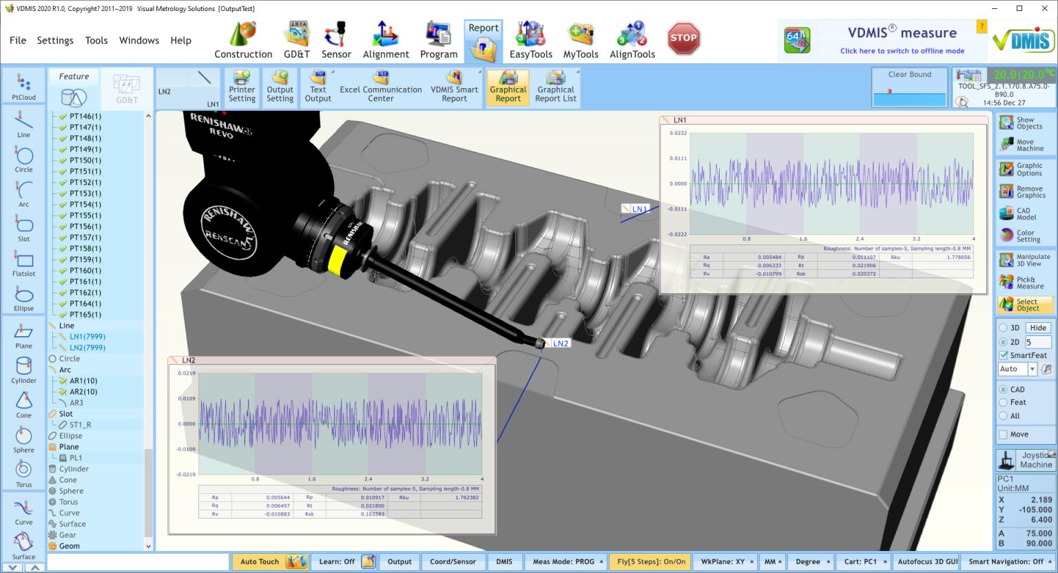
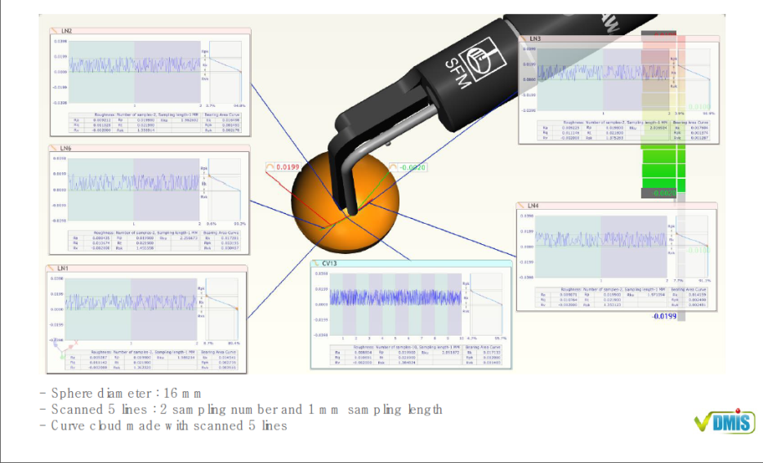
VDMIS Smart Surface Finishing Measurement
Auto probe angles
Auto line to be scanned
Supports filtering
2D graphical report
3D graphical report

Slide 36
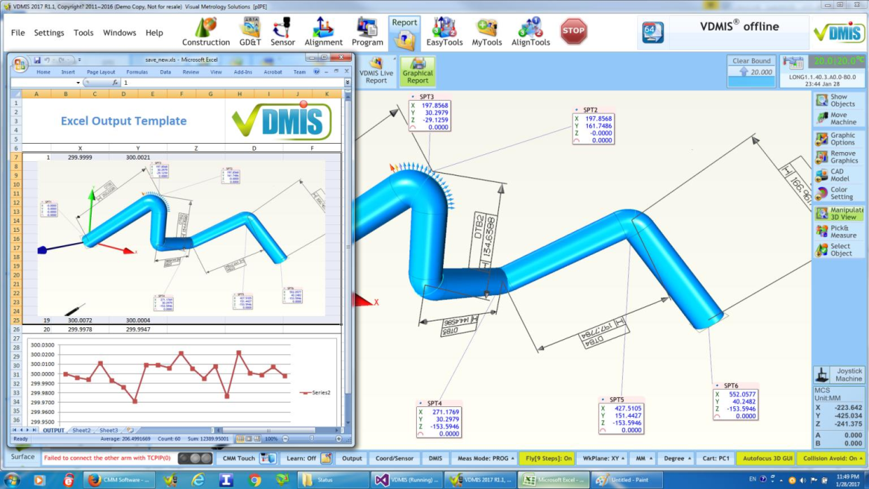
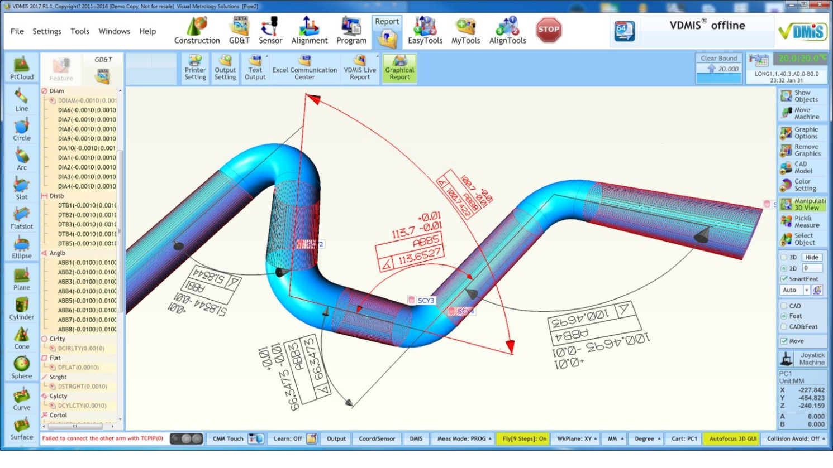
VDMIS Smart Pipe

Slide 37




VDMIS Smart Gear
Spur and helical gear
Auto measuring path

Slide 38


VDMIS Smart Vision
Accurate edge detection with edge matching
Easy programming with DMIS
Pattern matching

Slide 39
VDMIS Smart Connect
VDMIS Smart Remote Report
Space Mouse Interface
VDMIS Smart
Touch
VDMIS
VDMIS Smart External Connect
VDMIS Smart Interface
TCP-IP communication
Data export with DME codes
VDMIS Smart Remote Excel

